Slide 1
Introduction to Data Visualization
Data Visualization Course – Lecture 1
DATA VISUALIZATION
Mr. Ali Haider
Institute Of Management Sciences
Dr. Muhammad Sajjad
R.A: Imran Nawar
September 2024

Slide 2
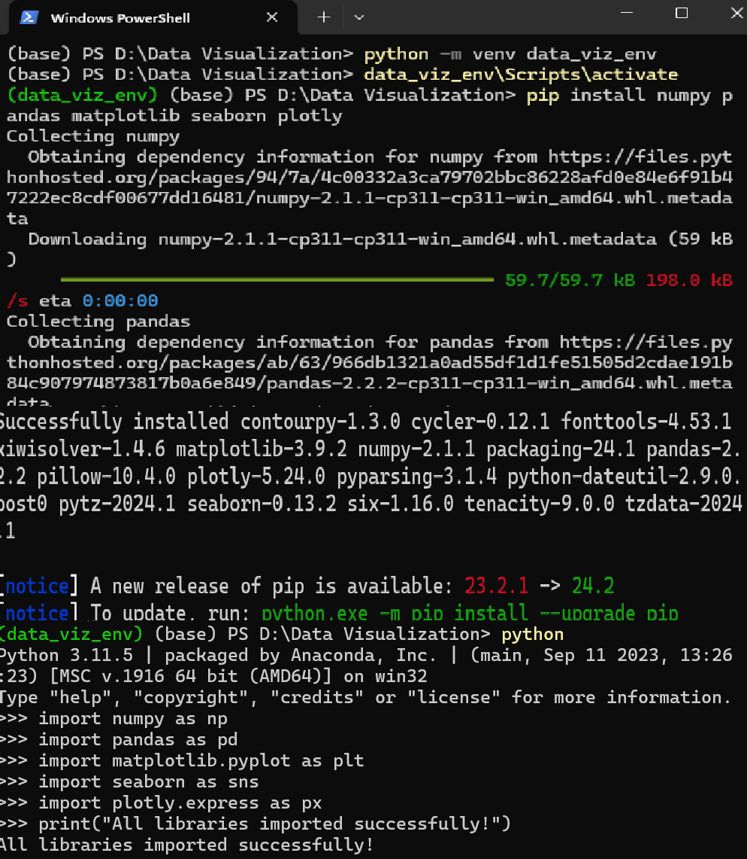
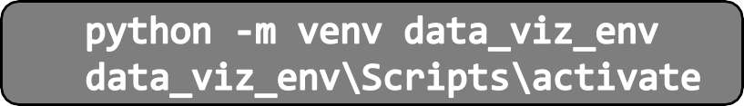
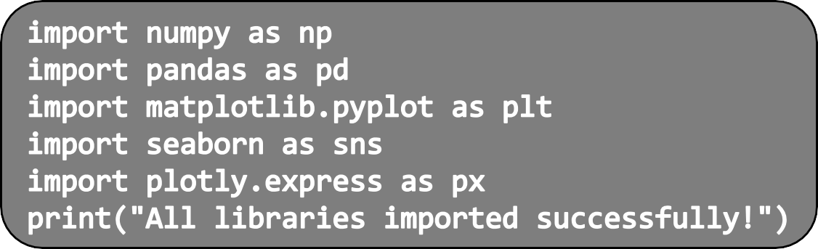
Coding: Python Environment Setup
To get started with data visualization in Python, follow these steps:
Install Python: Download and install the latest version of
Python from python.org.
Set up a virtual environment (optional but recommended):
Set up a coding environment:
🞄 Jupyter Notebook: Ideal for interactive coding.
🞄 VS Code / PyCharm: Full featured IDEs.
Install essential libraries:
5.Verify installations:

Slide 3
Thank You

